Slide 1

HIT3016 - SOFTWARE TEAM PROJECT
Tremors with Leap Motion
Team member:
Daniel CORSALETTI
Shengwei LI
Minh Duc NGUYEN
Joshua STOPPER
Tran Xuong TRAN

Slide 2
The Team
Team leader | Joshua Stopper
Documentation | Daniel Corsaletti
Research | Tran Xuong Tran
Testing | Shengwei Li
Technical support | Minh Duc Nguyen

Slide 3
Project Overview
Our client Dr. Phillip Michael is a surgeon for the Royal Victorian Eye & Ear Hospital
Dr. Michael discovered the Leap Motion controller nearly a year ago
Wants to be able to detect tremors in doctors and patients hands in a non invasive and costly manner
Wants to utilize the Leap Motion Controller to accomplish this

Slide 4
Scope
A proof of concept
Visualize user hand movement
Convert hand movement to 4 different outputs:
Velocity
Amplitude
Hertz
Acceleration

Slide 5
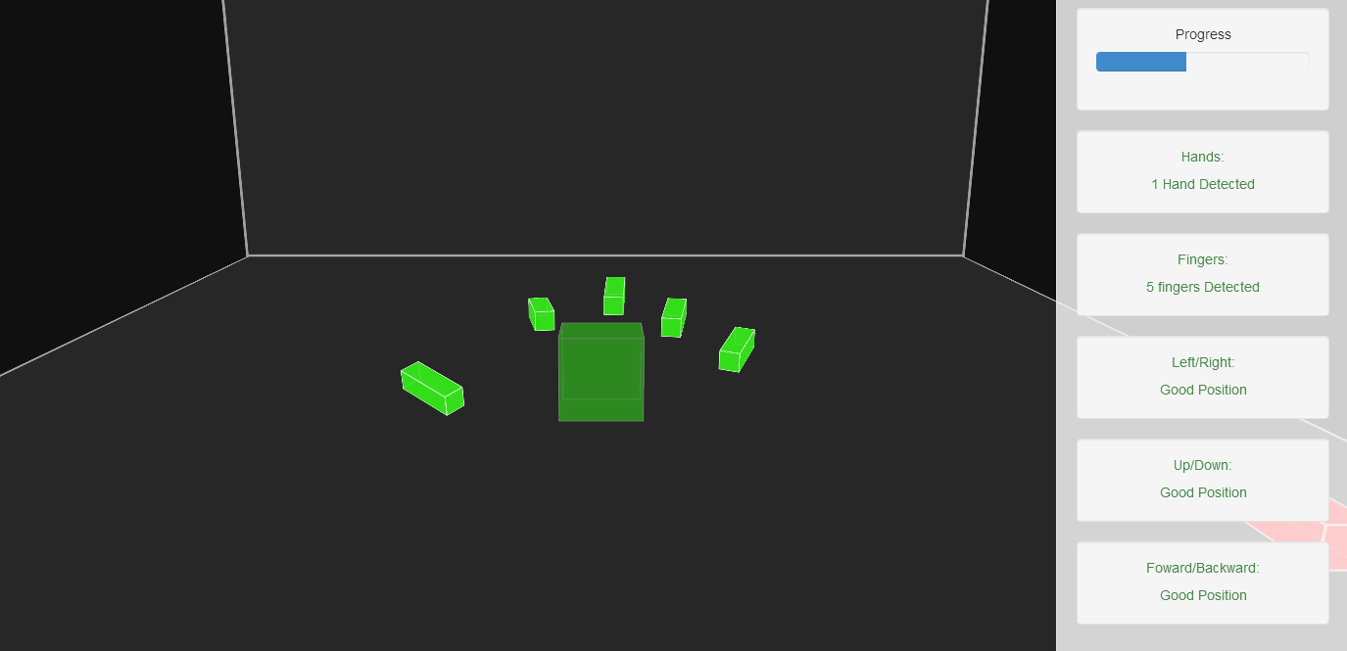
Proposed Solution

Slide 6
Contributions
Team Member | Contribution
Josh Stopper | Program developer
Daniel Corsaletti | Documentation, Testing
Minh Duc Nguyen | Program developer
Tran Xuong Tran | Documentation
Shengwei Li | Documentation

Slide 7
Usability Testing
Feedback from client used to design application
Testing based on potential environments
Test for use with gloves
Test under different lighting
Test while wearing jewelry
Check if client is able to conduct a tremor test using the on screen instructions and prompts

Slide 8
Function Testing
Video recordings of multiple tests with different degrees of tremor shown to client
Test data generated to run through functions
Functions work correctly, however Leap Motion device is not always capturing reliable data
Accuracy of Leap Motion device is affecting our results

Slide 9
Future Plans
Additional testing of Leap Motion device
Meet with client to discuss the outcomes of our project
Add information to technical manual about noise filter functionality
Present test data to client
Begin to wrap up project and finalize documentation

Slide 10
QUESTIONS!!!

